Slide 1
Data Mining & Knowledge Discovery
IME 672
Lecture 6

Slide 2
Contd…
Classification

Slide 3
Bayes Classification
Bayesian classifiers are statistical classifiers based on Bayes’ theorem
Predict class membership probabilities
Naive Bayesian classifier
Assumes effect of an attribute value on a given class is independent of the values of the other attributes – class conditional independence
Simplifies the computations
Has comparable performance with decision tree and selected neural network classifiers

Slide 4
Bayes Classification
Let X be a data sample (“evidence”): n attributes, class label unknown
H: some hypothesis such as that the data tuple X belongs to a specified class C
Find P(H|X): probability that the hypothesis H holds given the observed data tuple X
Probability that tuple X belongs to class C, given that we know the attribute description of X
P(H|X) a posteriori probability of H conditioned on X

Slide 5
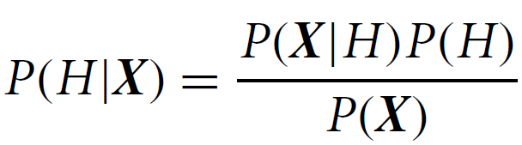
Bayes Classification
Baye’s theorem
Example: computer purchase problem
customers described by age and income
X is a 35-year-old customer with an income of $40,000
H: hypothesis that customer will buy a computer
P(H|X) = ?

Slide 6
Example
P(H|X): posterior probability that customer X will buy a computer given his age and income
P(H) is the prior probability that any given customer will buy a computer, regardless of age, income
P(X|H): posterior probability that customer X is 35 years old and earns $40,000, given that he buys a computer
P(X): prior probability that a person from the set of customers is 35 years old and earns $40,000
P(H), P(X|H), P(X) may be estimated from given data

Slide 7

Naive Bayesian Classification
D: training set of tuples. Each tuple represented by n-dimensional attribute vector, X=(x₁, x₂,…, x_{n}). Attributes are A₁, A₂,…, A_{n}. m classes - C₁, C₂,…, C_{m}
Given a tuple, X, the classifier will predict that X belongs to the class having the highest posterior probability, conditioned on X. Tuple X belongs to class C_{i} if and only if
By Bayes’ theorem

Slide 8
Naive Bayesian Classification
As P(X) is constant for all classes, only P(X|C_{i})P(C_{i}) needs to be maximized
If the class prior probabilities are not known, assume P(C₁)=P(C₂)=…=P(C_{m}), and therefore maximize P(X|C_{i})
Class prior probabilities may be estimated by P(C_{i}) = |C_{i,D}|/|D|
Given data sets with many attributes, extremely computationally expensive to compute P(X|C_{i})
Assumption: class-conditional independence, i.e., no dependence relation between attributes:

Slide 9
Naive Bayesian Classification
Attributes may be categorical or continuous
If A_{k} is categorical, P(x_{k}|C_{i}) is the # of tuples in C_{i} having value x_{k} for A_{k} divided by |C_{i, D}| (# of tuples of C_{i} in D)
If A_{k} is continous-valued, P(x_{k}|C_{i}) is usually computed based on Gaussian distribution with a mean μ and standard deviation σ
Compute P(X|C_{i}) for each class C_{i}
Predicted class label is class C_{i} for which P(X|C_{i}) is maximum

Slide 10
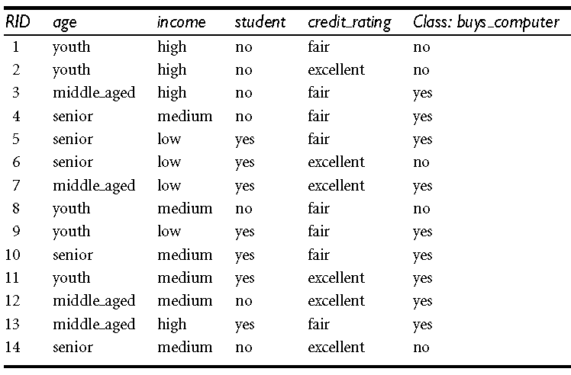
Example

Slide 11
Avoiding the Zero-Probability Problem
Naive Bayesian prediction requires each conditional prob. be non-zero. Otherwise, the predicted probability will be zero
Ex: A dataset with 1000 tuples, income=low (0), income= medium (990), and income = high (10)
Use Laplacian correction (or Laplacian estimator)
Adding 1 to each case
Prob(income = low) = 1/1003
Prob(income = medium) = 991/1003
Prob(income = high) = 11/1003
The “corrected” prob. estimates are close to their “uncorrected” counterparts

Slide 12
Naive Bayes Classifier: Comments
Advantages
Easy to implement
Good results obtained in most of the cases
Disadvantages
Assumption: class conditional independence, therefore loss of accuracy
Practically, dependencies exist among variables
E.g., Patients: Profile - age, family history, etc. Symptoms - fever, cough etc., Disease - lung cancer, diabetes, etc.
Dependencies among these cannot be modeled by Naïve Bayes Classifier

Slide 13
Bayesian Belief Networks
Unlike naive Bayesian classifiers, do not assume class conditional independence
Allow the representation of dependencies among subsets of attributes
Graphical model of causal relationships
Two components
a directed acyclic graph
set of conditional probability tables (CPT)
Node = random variable (discrete- or continuous)
Arc = probabilistic dependence

Slide 14
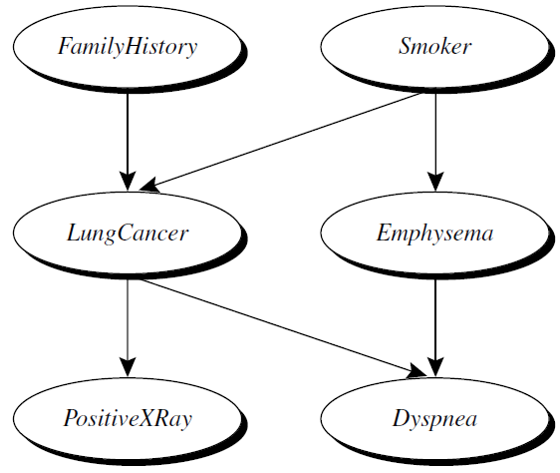
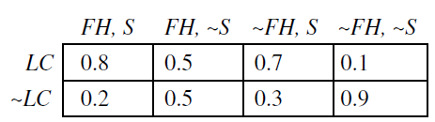
Bayesian Belief Networks
Arc Y -> Z implies Y is a parent, Z is a descendant

Slide 15
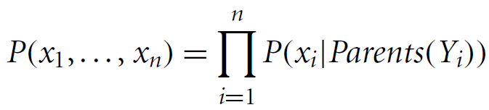
Bayesian Belief Networks
Each variable is conditionally independent of its non-descendants in the graph, given its parents
One CPT for each variable
X = (x₁,…, x_{n}) be a data tuple described by the variables or attributes Y₁,…, Y_{n}
Complete representation of the existing joint probability distribution

Slide 16
Bayesian Belief Networks
A node within the network can be selected as an “output” node, representing a class label attribute
May be more than one output node
Can return probability of each class
Various learning algorithms – gradient descent
Some applications
genetic linkage analysis
computer vision
document and text analysis
decision support systems
sensitivity analysis

